Slide 1


Slide 2

With
Your
Host...
Ms. Brown

Slide 3




Jeopardy
Ancient Civilizations
European Exploration
North American
Geography
Native American
Colonial America
Colonial America II
100
100
100
100
100
100
200
200
200
200
200
200
300
300
300
300
300
300
400
400
400
400
400
400
500
500
500
500
500
500

Slide 4
The original theory about how people came to the Americas via a land bridge between Siberia and Alaska.
A 100

Slide 5
What is the Bering Strait Theory?
A 100

Slide 6
The name for the people who’s remains were found at a site in New Mexico that had a similar culture.
A 200

Slide 7
Who are the Clovis People?
A 200

Slide 8
The theory that states the first people to come to the Americas came by the Pacific Ocean by boat.
A 300

Slide 9
What is the Pacific Coastal Theory?
A 300

Slide 10
The site in Chile that predated the Bering Strait theory.
A 400

Slide 11
What is Monte Verde?
A 400

Slide 12
MAP MINUTE!
Continents and Oceans
A 500

Slide 13
North America
South America
Antarctica
Australia
Europe
Africa
Asia
Pacific Ocean
Atlantic Ocean
Indian Ocean
Arctic Ocean
Southern Ocean
A 500

Slide 14
A Native American civilization that lived in the Caribbean in the 1300s – 1500s
B 100

Slide 15
Who are the Tainos?
B 100

Slide 16
A Native American civilization that compromised of 5 nations that ended their fighting in 1570 and lived in the Eastern Woodlands cultural region
B 200

Slide 17
Who are the Iroquois?
B 200

Slide 18
The primary source below is an excerpt from where?
“It appears to me, that the people are ingenious, and would be good servants and I am of opinion that they would very readily become Christians, as they appear to have no religion”.
B 300

Slide 19
What is Christopher Columbus’s journal, his desires to have the Taino Native Americans become slaves and convert to Christianity.
B 300

Slide 20
The excerpt from a secondary source below is most likely describing what historical event?
“When the above had been done, (the Spaniards) attempted to find out about the special storehouse of Montezuma, and he took them to his store hours, named Totocalco, which means, “bird house”. The Spaniards went along very joyfully, thinking that they would find much gold there, on arrival they took everything out of Montezuma’s own storehouse, where there were many precious items of gold, silver, and precious stones, and they took it all. They removed all the gold and stones from the rich feather-pieces and put the feathers in the middle of the courtyard for their friends to take.”
B 400

Slide 21
What is Hernando Cortez’s conquest of the Aztec emperor and plunder of Aztec gold.
B 400

Slide 22
Complete the sentence
Henry Hudson was the Dutch explorer who explored_______ and colonized the _________
B 500

Slide 23
Henry Hudson was the Dutch explorer who explored the Hudson River Valley; United States and colonized the Iroquois Native Americans
B 500

Slide 24
This was the main cause of the population change of Native Americans after the arrival of the Europeans
C 100

Slide 25
What are diseases such as smallpox
C 100

Slide 26
The three reasons for European Exploration
C 200

Slide 27
God, Gold and Glory
C 200

Slide 28
The Exchange of goods, ideas, and diseases
C 300

Slide 29
What is the Columbian Exchange?
C 300

Slide 30
DAILY DOUBLE
DAILY DOUBLE
Place A Wager
C 400

Slide 31
Which European nations had territory in the Americas in the 17th Century (1600s)
C 400

Slide 32
Who is France, England, Spain and the Netherlands
C 400

Slide 33
From who did England buy New York colony from?
C 500

Slide 34
Who are the Dutch? (The Netherlands, Holland)
C 500

Slide 35
A person who lives in a new community and is originally from another country
D 100

Slide 36
What is a colonist?
D 100

Slide 37
An original country that a colonist comes from
D 200

Slide 38
What is the mother country?
D 200

Slide 39
A settlement (a new community) made by a foreign country
D 300

Slide 40
What is a colony?
D 300

Slide 41
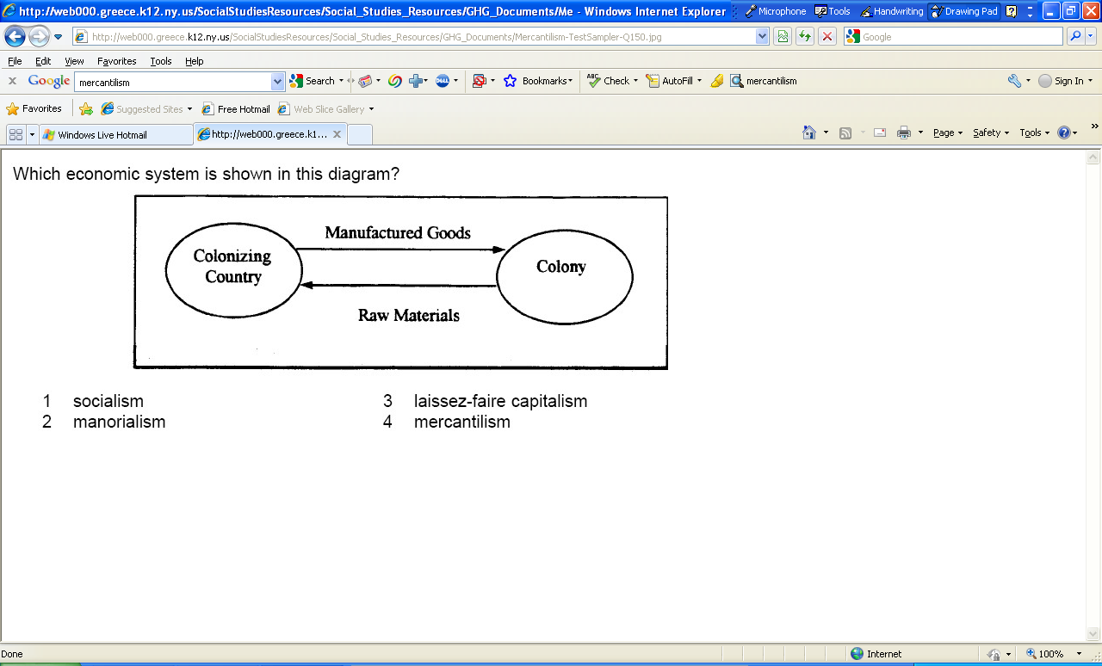
What economic principle is illustrated in the diagram?
D 400

Slide 42
What is mercantilism?
D 400

Slide 43
What is a potential problem with the system illustrated below?
D 500

Slide 44
The colony may feel that she is being exploited for raw materials/resources given to the mother country.
D 500

Slide 45
What is one similarity between slaves and indentured servants
E 100

Slide 46
Both were legally considered the property of their masters
E 100

Slide 47
The main reason people settled in Massachusetts, Pennsylvania, Rhode Island and Maryland
E 200

Slide 48
What is religious freedom?
E 200

Slide 49
Villages with town meetings, commercial fishing and small farms best describes this colonial region
E 300

Slide 50
What are the New England Colonies
E 300

Slide 51
In colonial America colonial assemblies (i.e. Virginia House of Burgesses) represented this
E 400

Slide 52
A step towards representative democracy
E 400

Slide 53
The Mayflower Compact introduced this principle
E 500

Slide 54
What is self government?
E 500

Slide 55
The document most closely associated with this 1754 political cartoon
F 100

Slide 56
What is the Albany Plan of Union?
F 100

Slide 57
This law forbid the colonists from crossing the Appalachian Mountains after the French and Indian War
F 200

Slide 58
What is the Proclamation of 1763?
F 200

Slide 59
White colonists and blacks fought together against the Native Americans in this event which led to the end of indentured servitude and began exclusive racial slavery
F 300

Slide 60
What is Bacon’s Rebellion?
F 300

Slide 61
What does it mean when a slave has been “broken in”?
F 400

Slide 62
The slave’s spirit is broken so they lose hope and no longer want to disobey the rules or fight back
F 400

Slide 63
MAP MINUTE!
13 Colonies
F 500

Slide 64
New Hampshire
Massachusetts
Rhode Island
Connecticut
Pennsylvania
Delaware
New York
New Jersey
Maryland
Virginia
North Carolina
South Carolina
Georgia
F 500

Slide 65
The Final Jeopardy Category is:
US Geography
Click on screen to begin

Slide 66
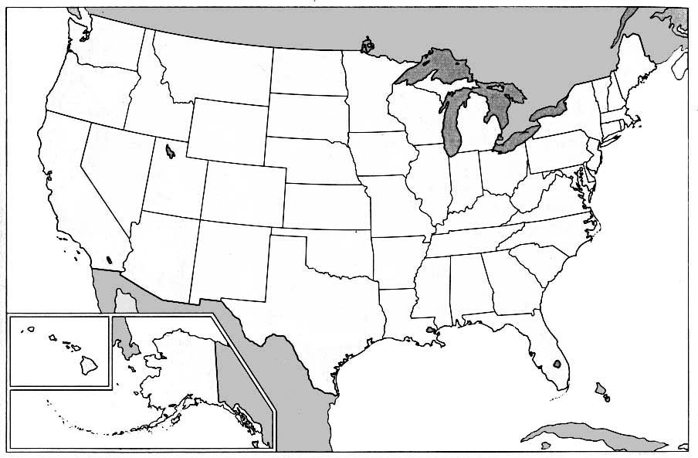
global history
Name the city where the arrow is pointing to

Slide 67
Answer: Washington, DC
Click on screen to continue

Slide 68
global history
Name the city where the arrow is pointing to

Slide 69
Answer: Albany, NY
Click on screen to continue

Slide 70
global history
Name the city where the arrow is pointing to

Slide 71
Answer: New York City
Click on screen to continue

Slide 72
Thank You for Playing Jeopardy!

